Slide 1
Lecture 9: More on String and Boolean
Building Java Programs: A Back to Basics Approach
by Stuart Reges and Marty Stepp
Copyright (c) Pearson 2013.
All rights reserved.

Slide 2
More on boolean

Slide 3
"Boolean Zen", part 1
Students new to boolean often test if a result is true:
  if (isPrime(57) == true) { // bad
  ...
  }
But this is unnecessary and redundant. Preferred:
  if (isPrime(57)) { // good
  ...
  }
A similar pattern can be used for a false test:
  if (isPrime(57) == false) { // bad
  if (!isPrime(57)) { // good

Slide 4
"Boolean Zen", part 2
Methods that return boolean often have an
if/else that returns true or false:
  public static boolean bothOdd(int n1, int n2) {
  if (n1 % 2 != 0 && n2 % 2 != 0) {
  return true;
  } else {
  return false;
  }
  }
  But the code above is unnecessarily verbose.

Slide 5
Solution w/ boolean var
We could store the result of the logical test.
  public static boolean bothOdd(int n1, int n2) {
  boolean test = (n1 % 2 != 0 && n2 % 2 != 0);
  if (test) { // test == true
  return true;
  } else { // test == false
  return false;
  }
  }
  Notice: Whatever test is, we want to return that.
    If test is true , we want to return true.
    If test is false, we want to return false.

Slide 6
Solution w/ "Boolean Zen"
Observation: The if/else is unnecessary.
  The variable test stores a boolean value;
  its value is exactly what you want to return. So return that!
  public static boolean bothOdd(int n1, int n2) {
  boolean test = (n1 % 2 != 0 && n2 % 2 != 0);
  return test;
  }
An even shorter version:
  We don't even need the variable test.
  We can just perform the test and return its result in one step.
  public static boolean bothOdd(int n1, int n2) {
  return (n1 % 2 != 0 && n2 % 2 != 0);
  }

Slide 7
"Boolean Zen" template
Replace
  public static boolean name(parameters) {
  if (test) {
  return true;
  } else {
  return false;
  }
  }
with
  public static boolean name(parameters) {
  return test;
  }

Slide 8
isPrime method
  public static boolean isPrime(int n) {
  int factors = 0;
  for (int i = 1; i <= n; i++) {
  if (n % i == 0) {
  factors++;
  }
  }
  if(factors==2)
  return true;
  else
  return false;
  }

Slide 9
Improved isPrime method
The following version utilizes Boolean Zen:
  public static boolean isPrime(int n) {
  int factors = 0;
  for (int i = 1; i <= n; i++) {
  if (n % i == 0) {
  factors++;
  }
  }
  return factors == 2; // if n has 2 factors, true
  }

Slide 10
"Short-circuit" evaluation
Java stops evaluating a test if it knows the answer.
  && stops early if any part of the test is false
  || stops early if any part of the test is true
  // Returns true if s1 and s2 end with the same two letters.
  public static boolean rhyme(String s1, String s2) {
  return s1.endsWith(s2.substring(s2.length() - 2)) &&
  s1.length() >= 2 && s2.length() >= 2;
  }
  The test will crash if s2's length is less than 2.

Slide 11
"Short-circuit” fix
The following test will not crash; it stops if length < 2:
  // Returns true if s1 and s2 end with the same two letters.
  public static boolean rhyme(String s1, String s2) {
  return s1.length() >= 2 && s2.length() >= 2 &&
  s1.endsWith(s2.substring(s2.length() - 2));
  }

Slide 12
De Morgan's Law
De Morgan's Law: Rules used to negate boolean tests.
  Useful when you want the opposite of an existing test.
  Example:
Original Expression | Negated Expression | Alternative
a && b | !a || !b | !(a && b)
a || b | !a && !b | !(a || b)
Original Code | Negated Code
if (x == 7 && y > 3) { ... } | if (x != 7 || y <= 3) { ... }

Slide 13
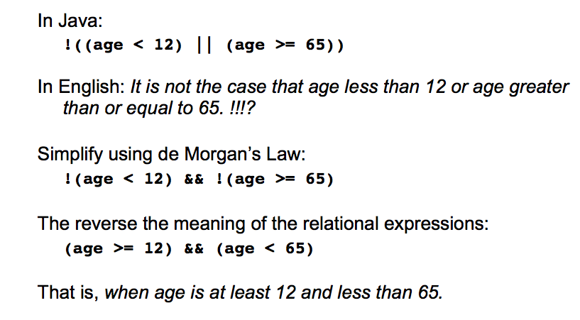
De Morgan’s Law

Slide 14
Boolean practice questions
Write a method named isVowel that returns whether a String is a vowel (a, e, i, o, or u). Assume all letters are lowercase.
  isVowel("q") returns false
  isVowel("a") returns true
  isVowel("e") returns true
  public static boolean isVowel(String s) {
  return s.equals("a") || s.equals("e") ||
  s.equals("i") || s.equals("o") ||
  s.equals("u");
  }

Slide 15
Boolean practice questions
Change the above method by using DeMorgan’s Law into an isNonVowel that returns whether a String is any character except a vowel.
  isNonVowel("q") returns true
  isNonVowel("a") returns false
  isNonVowel("e") returns false
  // Enlightened "Boolean Zen" version
  public static boolean isNonVowel(String s) {
  return !s.equals("a") && !s.equals("e") &&
  !s.equals("i") && !s.equals("o") &&
  !s.equals("u");
  }

Slide 16
Boolean practice questions
Use isVowel to write isNonVowel.
  // Enlightened "Boolean Zen" version
  public static boolean isNonVowel(String s) {
  return !isVowel(s);
  }

Slide 17
Early Return

Slide 18
Early Return
  //returns the sum of even integers from 1 to n.
  public static int sum(int n) {
  int sum=0;
  for(int i=1;i<=n;i++){
  if(i%2==0)
  sum+=i;
  return sum;
  }
  }
  Method returns too early. A return statement causes the method to
  immediately exit.

Slide 19
Fixed
  //returns the sum of even integers from 1 to n.
  public static int sum(int n) {
  int sum=0;
  for(int i=1;i<=n;i++){
  if(i%2==0)
  sum+=i;
  }
  return sum;
  }
  Returns should be after the for loop.

Slide 20
Early Return?
  Is this an example of early return?
  //returns the first prime from m to n. If there are
  // none, returns -1.
  public static int early(int m, int n) {
  for(int i=m;i<=n;i++){
  if(isPrime(i))
  return i;
  }
  return -1;
  }
  Method returns correctly.

Slide 21
Example 1
  Write a method extract which accepts a string parameter str
  and returns the string consists of all vowels in str in the
  same order. Use isVowel. Assume str is all lowercase.
  public static String extract(String str){
  String temp=“”;
  for(int i=0;i<str.length();i++){
  String v=str.substring(i,i+1);
  if(isVowel(v))
  temp+=v;
  }
  return temp;
  }

Slide 22
Example 2
  Write a method hasVowel which accepts a String parameter str
  and returns whether the str contains any vowel. Use isVowel.
  Assume str is all lowercase.
  hasVowel(“ng”); //returns false
  hasVowel(“bbbacadabra”); // returns true
  public static String hasVowel(String str){
  for(int i=0;i<str.length();i++){
  String v=str.substring(i,i+1);
  if(isVowel(v))
  return true;
  }
  return false;
  }

Slide 23
Example 3
  Write a method consonant which accepts a String parameter str
  and returns whether the str contains ONLY consonants. Use
  isVowel.
  consonant(“bcdfghjk”); //returns true
  consonant(“bcdefgh”); //returns false
  hasVowel(“bbbacadabra”); // returns true
  public static String consonant(String str){
  for(int i=0;i<str.length();i++){
  String v=str.substring(i,i+1);
  if(isVowel(v))
  return false;
  }
  return true;}

Slide 24
Lab
Write another version of isVowel that accepts a one-character string str and returns whether str is a vowel (a, e, i, o, or u). Assume all letters are lowercase. Can you write this method with only one noncompound check? (without using || or &&)

Slide 25
Lab
  Write a method countVowels which accepts a String parameter str
  and returns the number of vowels found in str. You must
  use isVowel.
  countVowels(“welcome to java!”); // returns 6
  countVowels(“hello”); //returns 2

Slide 26
Lab
  Write a method onlyNonPrimes which accepts two integer a and b and
  returns true if the interval [a, b] contains only nonprimes. You must use
  isPrime.
  hasPrime(20,22); // returns true
  hasPrime(12,16); //returns false

